Slide 1

Chapter 2 ::
Programming Language Syntax
Programming Language Pragmatics
Michael L. Scott
Copyright © 2009 Elsevier

Slide 2
Regular Expressions
A regular expression is one of the following:
  A character
  The empty string, denoted by ε
  Two regular expressions concatenated
  Two regular expressions separated by | (i.e., or)
  A regular expression followed by the Kleene star (concatenation of zero or more strings)
Copyright © 2009 Elsevier

Slide 3
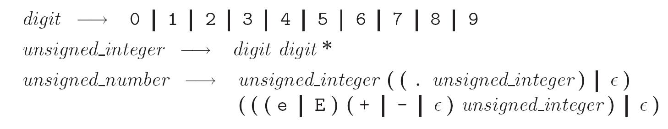
Regular Expressions
Numerical literals in Pascal may be generated by the following:
Copyright © 2009 Elsevier

Slide 4
Context-Free Grammars
The notation for context-free grammars (CFG) is sometimes called Backus-Naur Form (BNF)
A CFG consists of
  A set of terminals T
  A set of non-terminals N
  A start symbol S (a non-terminal)
  A set of productions
Copyright © 2009 Elsevier

Slide 5
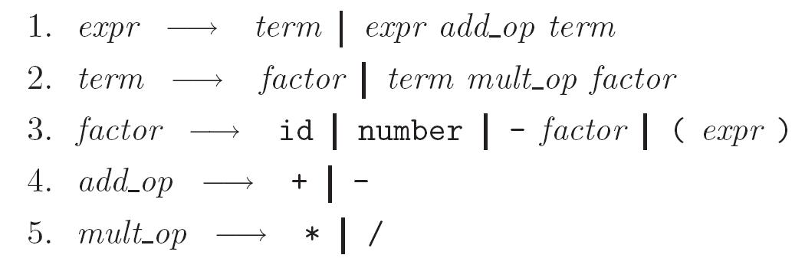
Context-Free Grammars
Expression grammar with precedence and associativity
Copyright © 2009 Elsevier

Slide 6
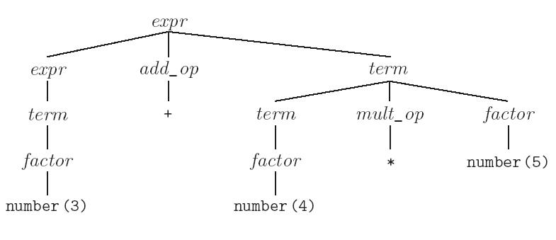
Context-Free Grammars
Parse tree for expression grammar (with precedence) for 3 + 4 * 5
Copyright © 2009 Elsevier

Slide 7
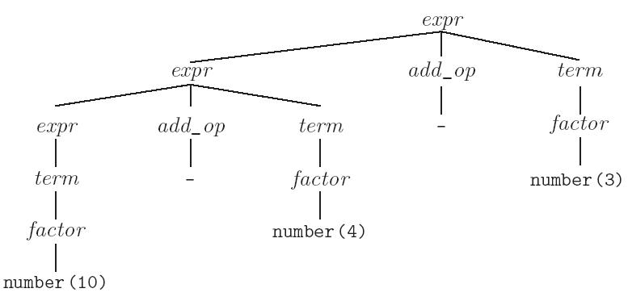
Context-Free Grammars
Parse tree for expression grammar (with left associativity) for 10 - 4 - 3
Copyright © 2009 Elsevier

Slide 8
Scanning
Recall scanner is responsible for
  tokenizing source
  removing comments
  (often) dealing with pragmas (i.e., significant comments)
  saving text of identifiers, numbers, strings
  saving source locations (file, line, column) for error messages
Copyright © 2009 Elsevier

Slide 9
Scanning
Suppose we are building an ad-hoc (hand-written) scanner for Pascal:
  We read the characters one at a time with look-ahead
If it is one of the one-character tokens
{ ( ) [ ] < > , ; = + - etc }
we announce that token
If it is a ., we look at the next character
  If that is a dot, we announce .
  Otherwise, we announce . and reuse the look-ahead
Copyright © 2009 Elsevier

Slide 10
Scanning
If it is a <, we look at the next character
  if that is a = we announce <=
  otherwise, we announce < and reuse the look-ahead, etc
If it is a letter, we keep reading letters and digits and maybe underscores until we can't anymore
  then we check to see if it is a reserve word
Copyright © 2009 Elsevier

Slide 11
Scanning
If it is a digit, we keep reading until we find a non-digit
  if that is not a . we announce an integer
  otherwise, we keep looking for a real number
  if the character after the . is not a digit we announce an integer and reuse the . and the look-ahead
Copyright © 2009 Elsevier

Slide 12
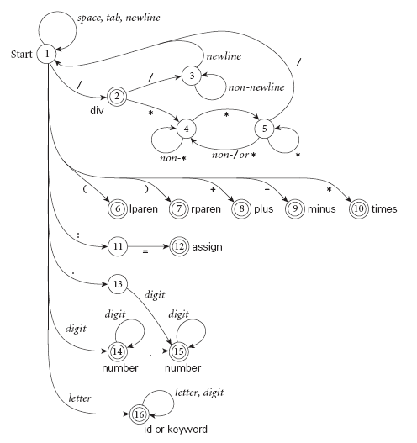
Scanning
Pictorial representation of a scanner for calculator tokens, in the form of a finite automaton
Copyright © 2009 Elsevier

Slide 13
Scanning
This is a deterministic finite automaton (DFA)
  Lex, scangen, etc. build these things automatically from a set of regular expressions
  Specifically, they construct a machine that accepts the language
  identifier | int const
  | real const | comment | symbol | ...
Copyright © 2009 Elsevier

Slide 14
Scanning
We run the machine over and over to get one token after another
  Nearly universal rule:
    always take the longest possible token from the input
    thus foobar is foobar and never f or foo or foob
    more to the point, 3.14159 is a real const and never 3, ., and 14159
Regular expressions "generate" a regular language; DFAs "recognize" it
Copyright © 2009 Elsevier

Slide 15
Scanning
Scanners tend to be built three ways
  ad-hoc
  semi-mechanical pure DFA
  (usually realized as nested case statements)
  table-driven DFA
Ad-hoc generally yields the fastest, most compact code by doing lots of special-purpose things, though good automatically-generated scanners come very close
Copyright © 2009 Elsevier

Slide 16
Scanning
Writing a pure DFA as a set of nested case statements is a surprisingly useful programming technique
  though it's often easier to use perl, awk, sed
  for details see Figure 2.11
Table-driven DFA is what lex and scangen produce
  lex (flex) in the form of C code
  scangen in the form of numeric tables and a separate driver (for details see Figure 2.12)
Copyright © 2009 Elsevier

Slide 17
Scanning
Note that the rule about longest-possible tokens means you return only when the next character can't be used to continue the current token
  the next character will generally need to be saved for the next token
In some cases, you may need to peek at more than one character of look-ahead in order to know whether to proceed
  In Pascal, for example, when you have a 3 and you a see a dot
    do you proceed (in hopes of getting 3.14)?
    or
    do you stop (in fear of getting 3..5)?
Copyright © 2009 Elsevier

Slide 18
Scanning
In messier cases, you may not be able to get by with any fixed amount of look-ahead.In Fortr an, for example, we have
DO 5 I = 1,25 loop
DO 5 I = 1.25 assignment
Here, we need to remember we were in a potentially final state, and save enough information that we can back up to it, if we get stuck later
Copyright © 2009 Elsevier

Slide 19
Parsing
Terminology:
  context-free grammar (CFG)
  symbols
    terminals (tokens)
    non-terminals
  production
  derivations (left-most and right-most - canonical)
  parse trees
  sentential form
Copyright © 2009 Elsevier

Slide 20
Parsing
By analogy to RE and DFAs, a context-free grammar (CFG) is a generator for a context-free language (CFL)
  a parser is a language recognizer
There is an infinite number of grammars for every context-free language
  not all grammars are created equal, however
Copyright © 2009 Elsevier

Slide 21
Parsing
It turns out that for any CFG we can create a parser that runs in O(n^3) time
There are two well-known parsing algorithms that permit this
  Early's algorithm
  Cooke-Younger-Kasami (CYK) algorithm
O(n^3) time is clearly unacceptable for a parser in a compiler - too slow
Copyright © 2009 Elsevier

Slide 22
Parsing
Fortunately, there are large classes of grammars for which we can build parsers that run in linear time
  The two most important classes are called
  LL and LR
LL stands for
'Left-to-right, Leftmost derivation'.
LR stands for
'Left-to-right, Rightmost derivation’
Copyright © 2009 Elsevier

Slide 23
Parsing
LL parsers are also called 'top-down', or 'predictive' parsers & LR parsers are also called 'bottom-up', or 'shift-reduce' parsers
There are several important sub-classes of LR parsers
  SLR
  LALR
We won't be going into detail on the differences between them
Copyright © 2009 Elsevier

Slide 24
Parsing
Every LL(1) grammar is also LR(1), though right recursion in production tends to require very deep stacks and complicates semantic analysis
Every CFL that can be parsed deterministically has an SLR(1) grammar (which is LR(1))
Every deterministic CFL with the prefix property (no valid string is a prefix of another valid string) has an LR(0) grammar
Copyright © 2009 Elsevier

Slide 25
Parsing
You commonly see LL or LR (or whatever) written with a number in parentheses after it
  This number indicates how many tokens of look-ahead are required in order to parse
  Almost all real compilers use one token of look-ahead
The expression grammar (with precedence and associativity) you saw before is LR(1), but not LL(1)
Copyright © 2009 Elsevier

Slide 26
LL Parsing
Here is an LL(1) grammar (Fig 2.15):
program → stmt list $$$
stmt_list → stmt stmt_list
| ε
stmt → id := expr
| read id
| write expr
expr → term term_tail
term_tail → add op term term_tail
| ε
Copyright © 2009 Elsevier

Slide 27
LL Parsing
LL(1) grammar (continued)
10. term → factor fact_tailt
11. fact_tail → mult_op fact fact_tail
| ε
factor → ( expr )
| id
| number
add_op → +
| -
mult_op → *
| /
Copyright © 2009 Elsevier

Slide 28
LL Parsing
Like the bottom-up grammar, this one captures associativity and precedence, but most people don't find it as pretty
  for one thing, the operands of a given operator aren't in a RHS together!
  however, the simplicity of the parsing algorithm makes up for this weakness
How do we parse a string with this grammar?
  by building the parse tree incrementally
Copyright © 2009 Elsevier

Slide 29
LL Parsing
Example (average program)
read A
read B
sum := A + B
write sum
write sum / 2
We start at the top and predict needed productions on the basis of the current left-most non-terminal in the tree and the current input token
Copyright © 2009 Elsevier

Slide 30
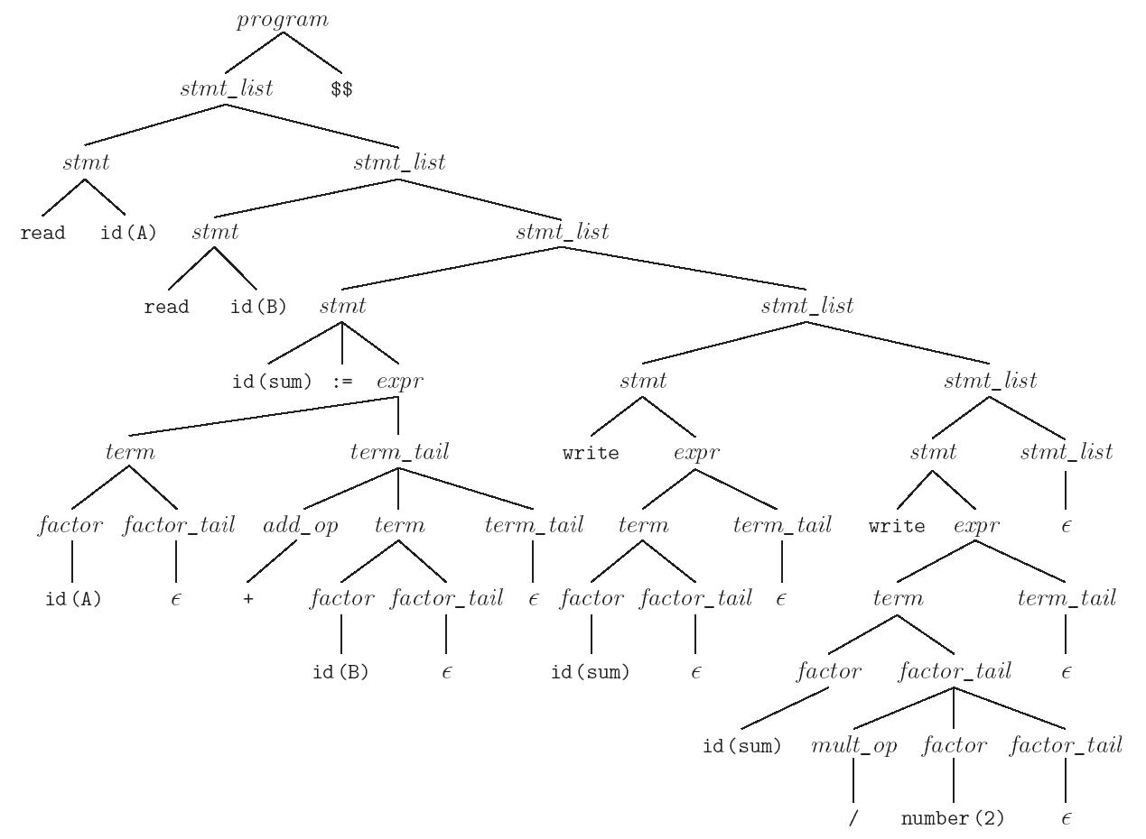
LL Parsing
Parse tree for the average program (Figure 2.17)
Copyright © 2009 Elsevier

Slide 31
LL Parsing
Table-driven LL parsing: you have a big loop in which you repeatedly look up an action in a two-dimensional table based on current leftmost non-terminal and current input token. The actions are
  (1) match a terminal
  (2) predict a production
  (3) announce a syntax error
Copyright © 2009 Elsevier

Slide 32
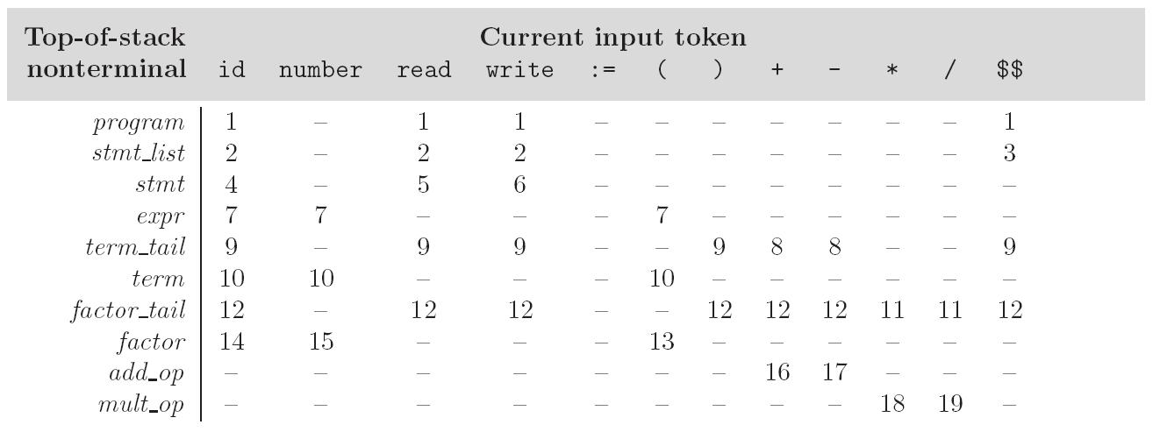
LL Parsing
LL(1) parse table for parsing for calculator language
Copyright © 2009 Elsevier

Slide 33
LL Parsing
To keep track of the left-most non-terminal, you push the as-yet-unseen portions of productions onto a stack
  for details see Figure 2.20
The key thing to keep in mind is that the stack contains all the stuff you expect to see between now and the end of the program
  what you predict you will see
Copyright © 2009 Elsevier

Slide 34
LL Parsing
Problems trying to make a grammar LL(1)
  left recursion
    example:
    id_list → id | id_list , id
    equivalently
    id_list → id id_list_tail
    id_list_tail → , id id_list_tail
    | epsilon
    we can get rid of all left recursion mechanically in any grammar
Copyright © 2009 Elsevier

Slide 35
LL Parsing
Problems trying to make a grammar LL(1)
  common prefixes: another thing that LL parsers can't handle
    solved by "left-factoring”
    example:
    stmt → id := expr | id ( arg_list )
    equivalently
    stmt → id id_stmt_tail
    id_stmt_tail → := expr
    | ( arg_list)
    we can eliminate left-factor mechanically
Copyright © 2009 Elsevier

Slide 36
LL Parsing
Note that eliminating left recursion and common prefixes does NOT make a grammar LL
  there are infinitely many non-LL LANGUAGES, and the mechanical transformations work on them just fine
  the few that arise in practice, however, can generally be handled with kludges
Copyright © 2009 Elsevier

Slide 37
LL Parsing
Problems trying to make a grammar LL(1)
  the"dangling else" problem prevents grammars from being LL(1) (or in fact LL(k) for any k)
  the following natural grammar fragment is ambiguous (Pascal)
    stmt → if cond then_clause else_clause | other_stuff
    then_clause → then stmt
    else_clause → else stmt
    | epsilon
Copyright © 2009 Elsevier

Slide 38
LL Parsing
The less natural grammar fragment can be parsed bottom-up but not top-down
  stmt → balanced_stmt | unbalanced_stmt
  balanced_stmt → if cond then balanced_stmt
  else balanced_stmt
  | other_stuff
  unbalanced_stmt → if cond then stmt
  | if cond then balanced_stmt
  else unbalanced_stmt
Copyright © 2009 Elsevier

Slide 39
LL Parsing
The usual approach, whether top-down OR bottom-up, is to use the ambiguous grammar together with a disambiguating rule that says
  else goes with the closest then or
  more generally, the first of two possible productions is the one to predict (or reduce)
Copyright © 2009 Elsevier

Slide 40
LL Parsing
Better yet, languages (since Pascal) generally employ explicit end-markers, which eliminate this problem
In Modula-2, for example, one says:
  if A = B then
  if C = D then E := F end
  else
  G := H
  end
Ada says 'end if'; other languages say 'fi'
Copyright © 2009 Elsevier

Slide 41
LL Parsing
One problem with end markers is that they tend to bunch up. In Pascal you say
if A = B then …
else if A = C then …
else if A = D then …
else if A = E then …
else ...;
With end markers this becomes
  if A = B then …
  else if A = C then …
  else if A = D then …
  else if A = E then …
  else ...;
  end; end; end; end;
Copyright © 2009 Elsevier

Slide 42
LL Parsing
The algorithm to build predict sets is tedious (for a "real" sized grammar), but relatively simple
It consists of three stages:
  (1) compute FIRST sets for symbols
  (2) compute FOLLOW sets for non-terminals
  (this requires computing FIRST sets for some strings)
  (3) compute predict sets or table for all productions
Copyright © 2009 Elsevier

Slide 43
LL Parsing
It is conventional in general discussions of grammars to use
  lower case letters near the beginning of the alphabet for terminals
  lower case letters near the end of the alphabet for strings of terminals
  upper case letters near the beginning of the alphabet for non-terminals
  upper case letters near the end of the alphabet for arbitrary symbols
  greek letters for arbitrary strings of symbols
Copyright © 2009 Elsevier

Slide 44
LL Parsing
Algorithm First/Follow/Predict:
  FIRST(α) == {a : α →* a β}
  ∪ (if α =>* ε THEN {ε} ELSE NULL)
  FOLLOW(A) == {a : S →⁺ α A a β}
  ∪ (if S →* α A THEN {ε} ELSE NULL)
  Predict (A → X₁ ... X_{m}) == (FIRST (X₁ ... X_{m}) - {ε}) ∪ (if X₁, ..., X_{m} →* ε then FOLLOW (A) ELSE NULL)
Details following…
Copyright © 2009 Elsevier

Slide 45
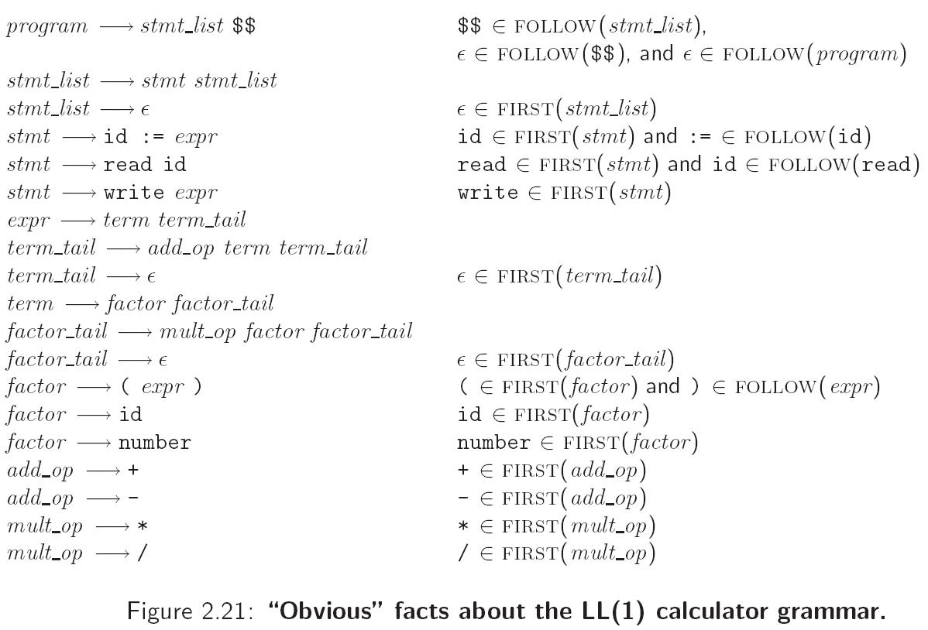
LL Parsing
Copyright © 2009 Elsevier

Slide 46
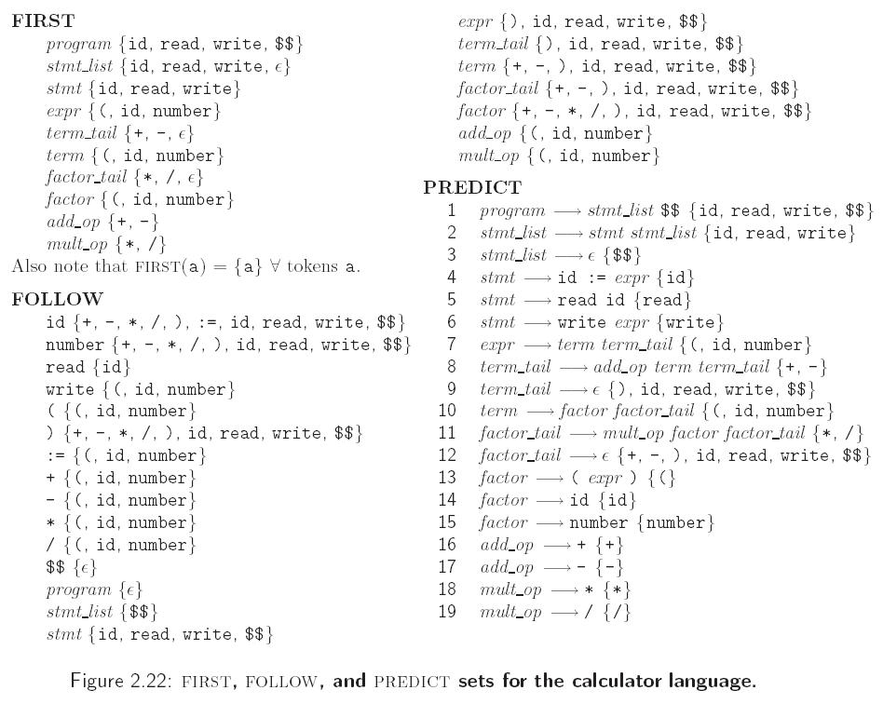
LL Parsing
Copyright © 2009 Elsevier

Slide 47
LL Parsing
If any token belongs to the predict set of more than one production with the same LHS, then the grammar is not LL(1)
A conflict can arise because
  the same token can begin more than one RHS
  it can begin one RHS and can also appear after the LHS in some valid program, and one possible RHS is ε
Copyright © 2009 Elsevier

Slide 48
LR Parsing
LR parsers are almost always table-driven:
  like a table-driven LL parser, an LR parser uses a big loop in which it repeatedly inspects a two-dimensional table to find out what action to take
  unlike the LL parser, however, the LR driver has non-trivial state (like a DFA), and the table is indexed by current input token and current state
  the stack contains a record of what has been seen SO FAR (NOT what is expected)
Copyright © 2009 Elsevier

Slide 49
LR Parsing
A scanner is a DFA
  it can be specified with a state diagram
An LL or LR parser is a PDA
  Early's & CYK algorithms do NOT use PDAs
  a PDA can be specified with a state diagram and a stack
    the state diagram looks just like a DFA state diagram, except the arcs are labeled with <input symbol, top-of-stack symbol> pairs, and in addition to moving to a new state the PDA has the option of pushing or popping a finite number of symbols onto/off the stack
Copyright © 2009 Elsevier

Slide 50
LR Parsing
An LL(1) PDA has only one state!
  well, actually two; it needs a second one to accept with, but that's all (it's pretty simple)
  all the arcs are self loops; the only difference between them is the choice of whether to push or pop
  the final state is reached by a transition that sees EOF on the input and the stack
Copyright © 2009 Elsevier

Slide 51
LR Parsing
An SLR/LALR/LR PDA has multiple states
  it is a "recognizer," not a "predictor"
  it builds a parse tree from the bottom up
  the states keep track of which productions we might be in the middle
The parsing of the Characteristic Finite State Machine (CFSM) is based on
  Shift
  Reduce
Copyright © 2009 Elsevier

Slide 52
LR Parsing
To illustrate LR parsing, consider the grammar (Figure 2.24, Page 73):
program → stmt list $$$
stmt_list → stmt_list stmt
| stmt
stmt → id := expr
| read id
| write expr
expr → term
| expr add op term
Copyright © 2009 Elsevier

Slide 53
LR Parsing
LR grammar (continued):
9. term → factor
| term mult_op factor
factor →( expr )
| id
| number
add op → +
| -
mult op → *
| /
Copyright © 2009 Elsevier

Slide 54
LR Parsing
This grammar is SLR(1), a particularly nice class of bottom-up grammar
  it isn't exactly what we saw originally
  we've eliminated the epsilon production to simplify the presentation
For details on the table driven SLR(1) parsing please note the following slides
Copyright © 2009 Elsevier

Slide 55
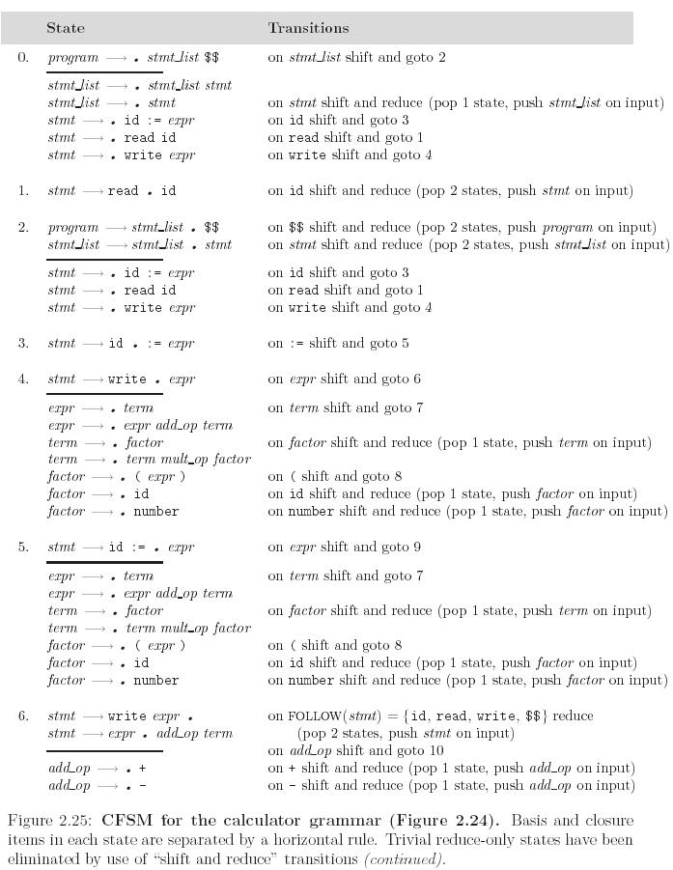
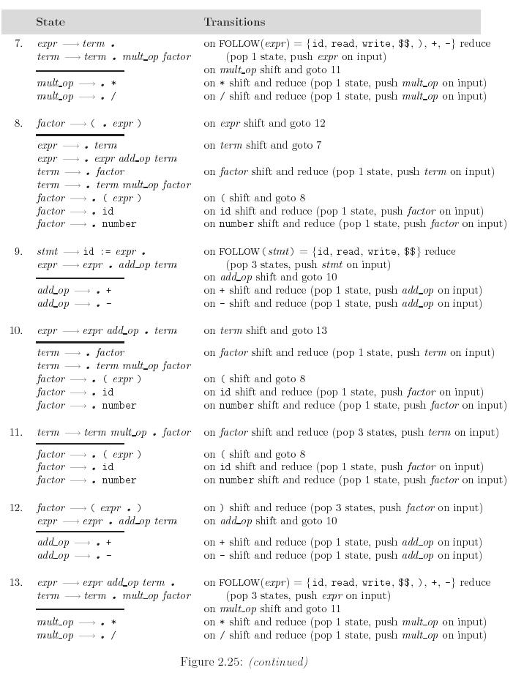
LR Parsing
Copyright © 2009 Elsevier

Slide 56
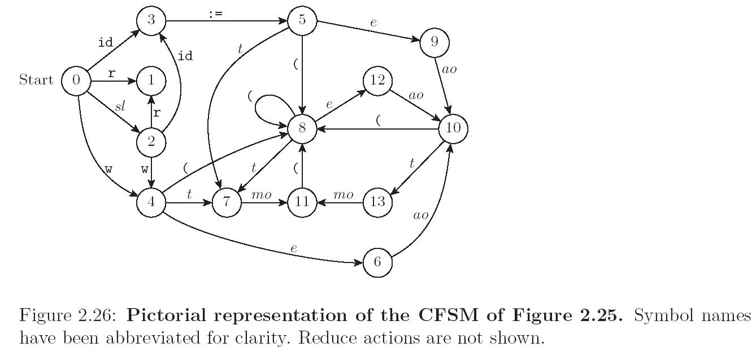
LR Parsing
Copyright © 2009 Elsevier

Slide 57
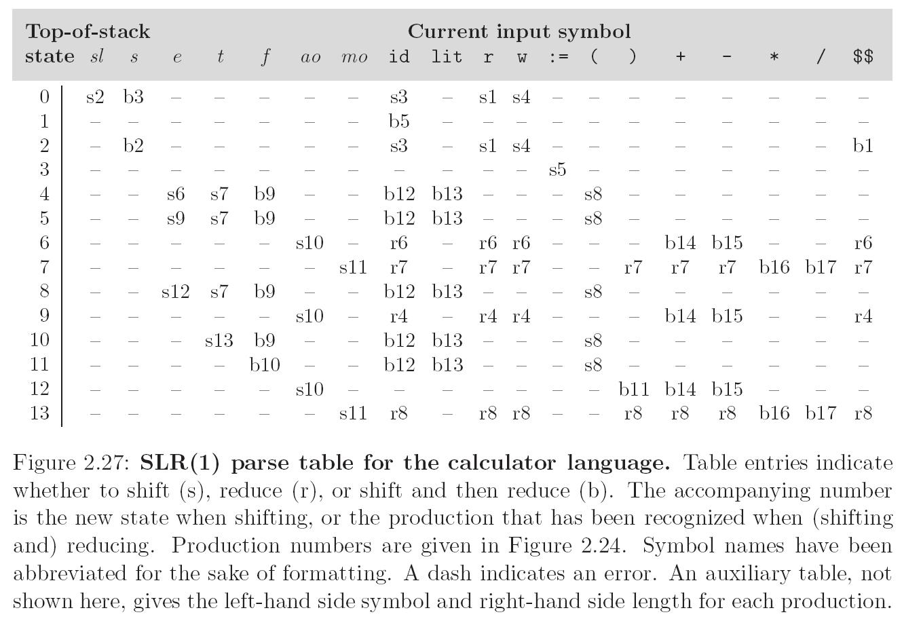
LR Parsing
Copyright © 2009 Elsevier

Slide 58
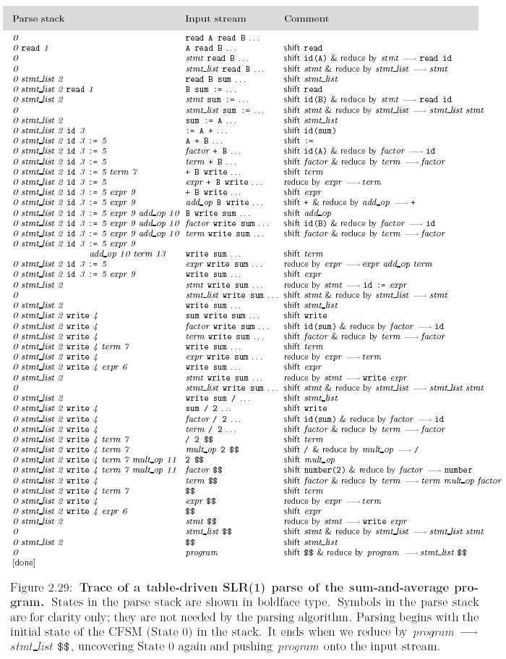
LR Parsing
SLR parsing is based on
  Shift
  Reduce
  and also
  Shift & Reduce (for optimization)
Copyright © 2009 Elsevier

